Slide 1

Dog Breed Detection and Identification program

Slide 2
What is my Current Project
The Purpose of my project is to create a program to take in images and then extract the feature of the dog present within the picture.
Then utilising the features that were obtain from the inputted dog image to then obtain the breed of the dog that is present with the picture.

Slide 3
Why I choose this Project
The reason why I chose this project is because I personally have always love dogs, no matter the size or shape I have always had a soft spot for dogs.
Though with my quite abysmal memory I could never figure out what were the breeds of dog that I that I had admired.
So I have chosen to undertake this project to enable myself and others to be able to identify the many different dog breed that are present in our world and what they need to live a for filling life

Slide 4
Tech Stack
For this project I have decided to utilise anaconda as the workbench for the creation of this project.
I have also chosen python as the language that I will utilise for the development of this project.
The anaconda work bench is very customisable and is a good workbench for the utilisation of machine learning.
Python is great language for large and small scale project, is also contains many pre-processing package for my project

Slide 5
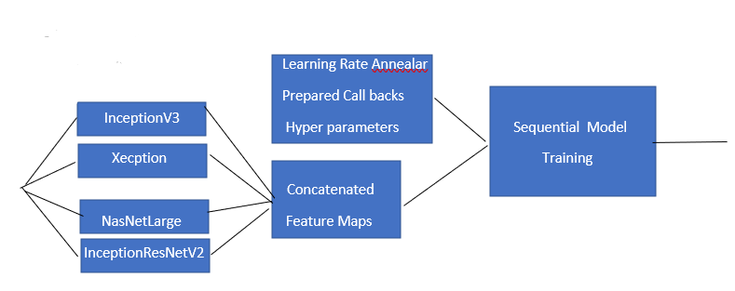
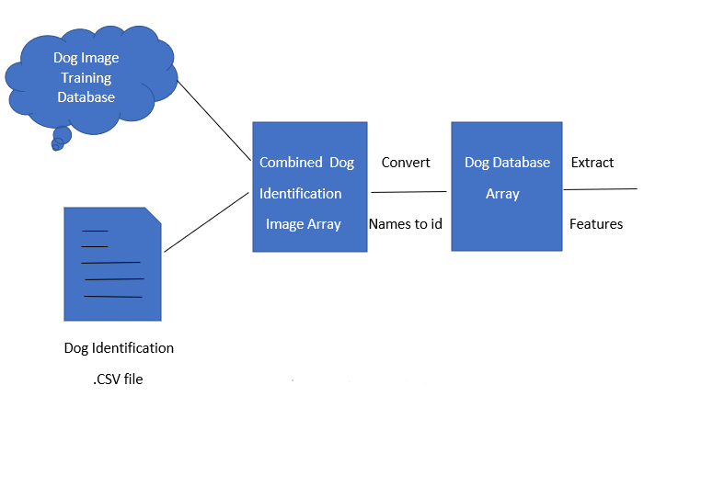
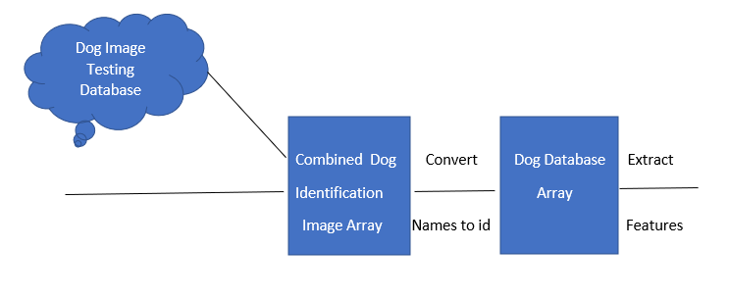
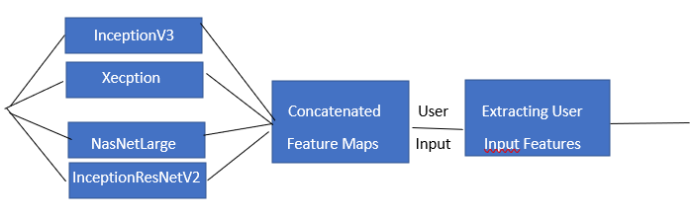
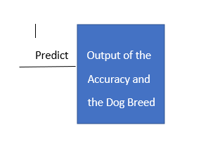
Current System Architecture

Slide 6
Project
I created a variable Breeds that is associated to the label.CSV file, I then took that info and sorted it and gave each breed a unique id.
I then created a function called imagesarray which converted the image present in the dog image database to a numerical format.
I then created a function to obtain the features of images and then used InceptionV3, Xception, NASNetLarge and InceptionResNetV2 for the feature mapping.
Then I ran the feature map through a sequential model to test the accuracy of the model.
Finally I recreated the two previous methods of imagearray and the getfeature function, then obtain the feature maps from the testing dog image database and inputted my own dog image and predicted the breed of the dog.

Slide 7
What I can improve about the project
There are many additional aspect that I can add to my project such as:
Adding additional species to the database to have a wider range of dog breed to identify.
Adding additional information about each dog breed such as, what show they need, their age limits etc.
Moving the project on to a website format to all for both mobile and website access for on the fly access and processing.

Slide 8
Question
Thank you listening to my PowerPoint presentation.
Any questions.

